Slide 1

Working with sonar data and ICES metadata
Sigurvin Bjarnason
Acoustic talk December 2025

Slide 2
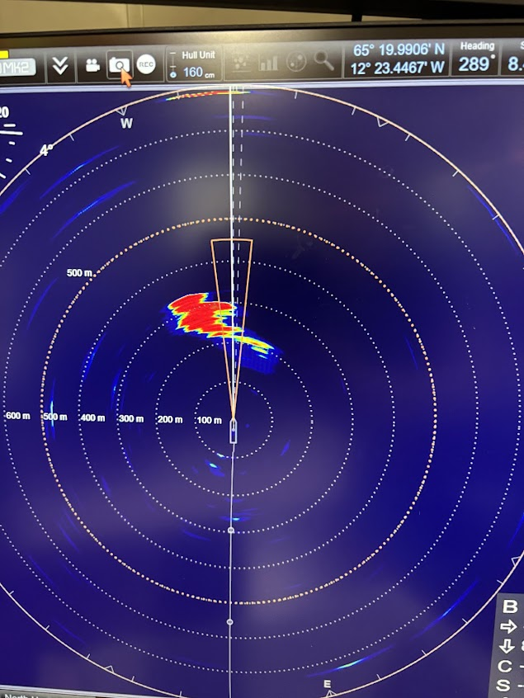
Sonar/ Astic
What is sonar?
Sonar is a tool that uses sound waves to “see” underwater.
It works similar to how bats use echolocation or how medical ultrasound works.
Works the same way as the EK80/ES80- and causes interference
It helps vessels detect fish, schools, obstacles, and the seabed.
Notes:
A.S.T.I.C = Automatic Scanning Tracking Integrated Controller

Slide 3
ST90/SU90/MF90
omnidirectional sonar — it scans 360° around the vessel, not just below it.
It shows what is happening far ahead of the vessel (several hundred meters).
ST90 Long-range 14-24 kHz fish-finding omnidirectional
SU90 Long-range 20-30 kHz fish-finding omnidirectional sonar
MF90 Medium-frequency omnidirectional fish-finding sonar () 75 to 85 kHz.)
can tilt the beam so you can look at different depths.
produces a real-time “live view” of fish schools moving around the vessel.
is widely used in pelagic fisheries (herring, mackerel, capelin).
Notes:
Why do fishing vessels use it?
Helps find fish faster, saving fuel and time.
Reduces unnecessary searching.
Helps aim trawls more precisely.
Can identify whether a school is worth catching.
Improves safety by avoiding obstacles or shallow areas.

Slide 4
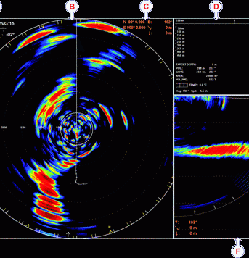
Sonar data for fisheries managment
Have been used to:
Detect migration patterns (Hafsteinsson and Misund, 1995; Trygonis et al., 2009; Peraltilla and Bertrand, 2014)
Map schooling fish near the surface (Misund et al., 1996a)
Detect fish avoidance reactions (Misund et al., 1996b; Soria et al., 1996; Peña et al., 2013)
Evaluate single school size and fish abundance (Misund, 1993; Tang et al., 2006; Nishimori et al., 2009; Tenningen et al., 2015)

Slide 5
Data can be used in LSSS
“Processing system for omnidirectional fisheries sonar” (PROFOS)
Working with data from the SU90 sonar
We have recordings from capelin and herring cruises – needs work/time

Slide 6
What is metadata?
Metadata is data, describing data
Should allow potential users to determine the fitness for their purposes of that data from the metadata alone, without having to access the actual data.

Slide 7
Ensuring data quality and transparency
Metadata describes how the data was collected:
Vessel name, platform type, nationality
Equipment used (echosounder type, frequency, transducers)
Calibration settings
Cruise dates and protocols

Slide 8
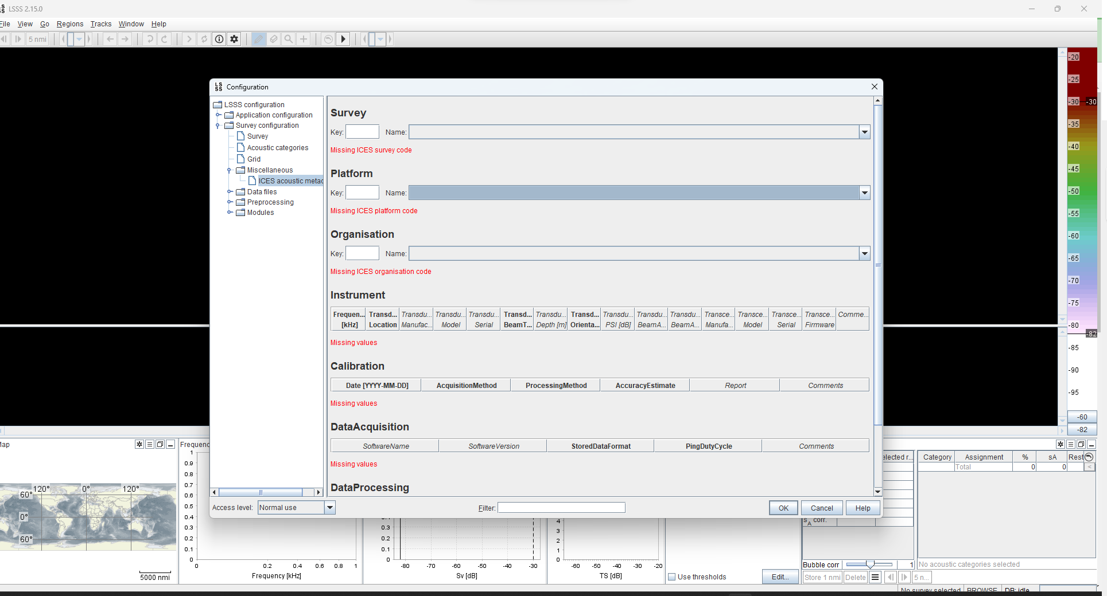
ICES Metadata in LSSS

Slide 9
ICES Metadata
https://www.ices.dk/data/data-portals/Pages/acoustic.aspx
Code | Description | Code type |  | Created | Modified
46AS | ARNI FRIDRIKSSON | SHIPC | False | 2014-02-04 | 2021-05-25
46BS | BJARNI SAEMUNDSSON | SHIPC | False | 2006-12-21 | 2020-09-30
ICES metadata is essential for uploading into ICES acoustic database
If not there, you can contact acoustic@ices.dk, to add the necessary info.
Notes:
Codes to type in to webpage
ARNI
MFRI
IESNS

Slide 10
What about (future?) Hafró database? Discussions
The metadata „head“ to the ListUserfile25 will not be a requirement
Recommendation : Fill in the metadata for all surveys and generate all reports!
However, using „homemade“ keys:
Platform (Already for Arni and Bjarni, what about rentals?)
Survey (International surveys have keys, what about ISSH, capelin and more?)
Organization (might skip, but we have a partnership with Greenland?)
http://hafatt:5011/

Slide 11
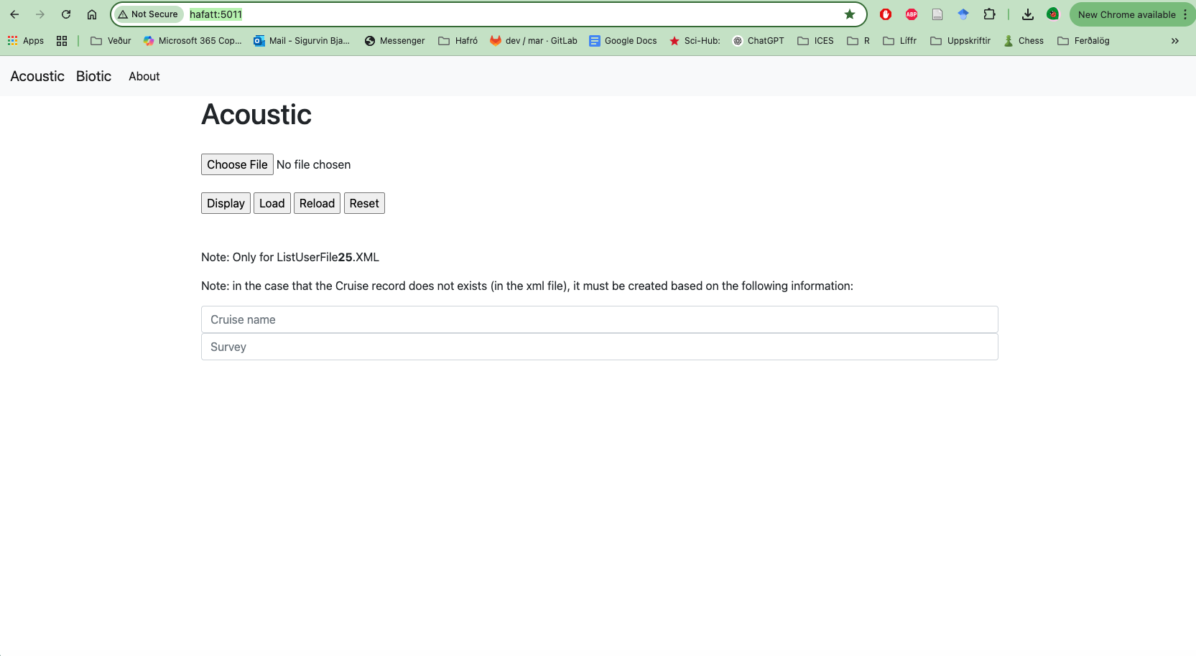

Slide 12
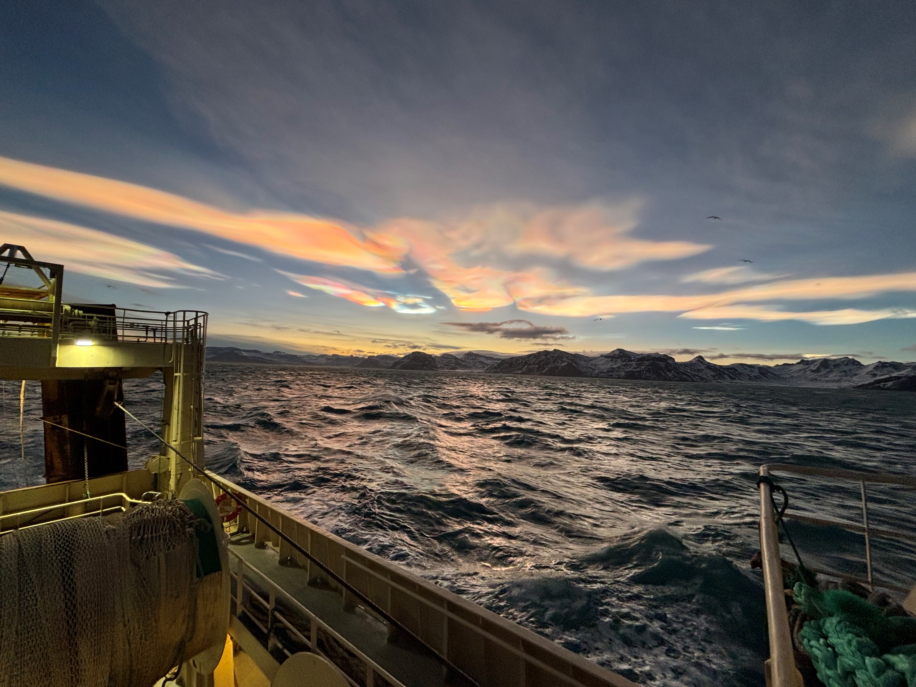
Takk fyrir

